Slide 1
Contact
Alex Ford
PGCE History Lead Tutor
SHP Regional Advisor, Yorkshire & the Humber
@apf102
www.andallthat.co.uk
a.ford@leedstrinity.ac.uk

Slide 2
3 years ago…
“As part of our reforms to the national curriculum , the current system of ‘levels’ used to report children’s attainment and progress will be removed. It will not be replaced.” (DfE, 2013)

Slide 3
“We have been granted everything, yet we have been granted nothing.”
18 months ago…
What is to be done to further the revolution in National Curriculum levels?
So…what do we do now?

Slide 4
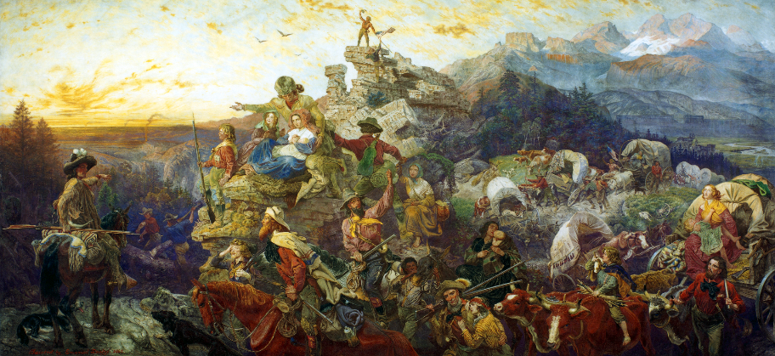
Journey to the promised land? Mastering and assessing history after the demise of levels
Alex Ford – Senior Lecturer, Leeds Trinity University

Slide 5
Pupils
Comment marking on work
Teachers
Reflections on a lesson
One to one discussions with students
Effort grades on work
NC Levels / GCSE grades each lesson
Levels entered on a data system
Analysis of class/year set of exam results
NC Levels / GCSE grades on pieces of work
NC Levels / GCSE grades each half term
NC Levels / GCSE grades at the end of a year
Effort grades over a term
Parents’ evening appointments
Parents
Annual reports
Based on Burnham & Brown (2014)

Slide 6
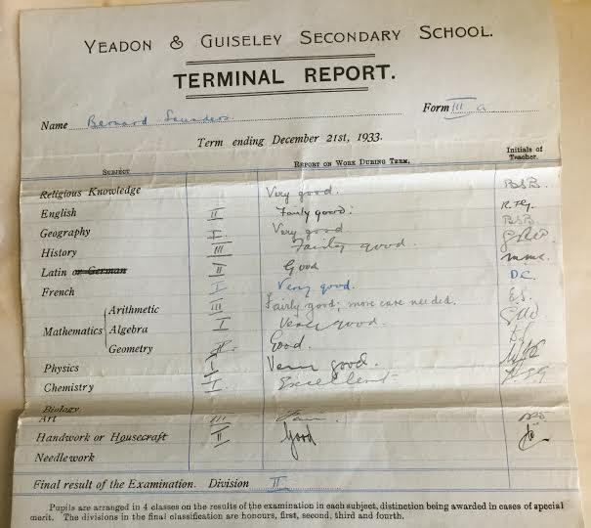
Pupils
Teachers
Help teachers to establish attainment and progress of pupils.
Identify and plan for next steps
Inform students of attainment and progress made
Help students to improve
Gain an understanding of their child’s strengths/weaknesses.
Establish if they are making suitable progress.
Parents

Slide 7
Pupils
Comment marking on work
Teachers
Reflections on a lesson
DATA MANAGERS
One to one discussions with students
Effort grades on work
NC Levels / GCSE grades each lesson
Levels entered on a data system
Analysis of class/year set of exam results
NC Levels / GCSE grades on pieces of work
NC Levels / GCSE grades each half term
NC Levels / GCSE grades at the end of a year
Effort grades over a term
PROVING PROGRESS
Parents’ evening appointments
Parents
Annual reports

Slide 8
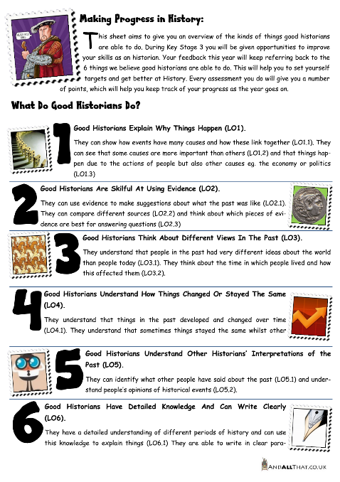
Establish a Gold Standard
“Competent historical thinkers understand both the vast differences that separate us from our ancestors and the ties that bind us to them; they can analyse historical artefacts and documents…they can assess the validity and relevance of historical accounts, when they are used to support entry into a war, voting for a candidate, or any of the myriad decisions knowledgeable citizens in a democracy must make. All this requires “knowing the facts,” but “knowing the facts” is not enough. Historical thinking does not replace historical knowledge: the two are related and interdependent.”
(Seixas, 2008, p. 6)

Slide 9
On the Trail: Practicalities

Slide 10
The Seductive Power of Levels

Slide 11
What’s wrong with NC Levels?
Demonstrate a clear understanding of the complexities of the relationship between cause, consequence and change
Demonstrate an awareness of human motivation illustrated by reference to events of the past
Demonstrate an awareness of the problems inherent in the idea of causation
Demonstrate, by reference to stories of the past, an awareness that actions have consequences
Produce a well-argued hierarchy of causes for complex historical issues
Recognise everyday time conventions
Understand that historical events have different types of causes and consequences
Understand that historical events usually have more than one cause and consequence
When examining historical issues, can draw the distinction between causes, motives and reasons
When explaining historical issues, place some causes and consequences in a sensible order of importance
CHALLENGE 1
The 10 statements all come from the National Curriculum Level Descriptions of 1991. They all relate to the concept of causation and theoretically form a hierarchy from Level 1 to Level 10.
PUT THEM IN THE RIGHT ORDER

Slide 12
Problem with NC Levels: Progression
Level 1 – Recognise everyday time conventions
Level 2 – Demonstrate, by reference to stories of the past, an awareness that actions have consequences
Level 3 – Demonstrate an awareness of human motivation illustrated by reference to events of the past
Level 4 – Understand that historical events usually have more than one cause and consequence
Level 5 – Understand that historical events have different types of causes and consequences
Level 6 – When explaining historical issues, place some causes and consequences in a sensible order of importance
Level 7 – When examining historical issues, can draw the distinction between causes, motives and reasons
Level 8 – Produce a well-argued hierarchy of causes for complex historical issues
Level 9 – Demonstrate an awareness of the problems inherent in the idea of causation
Level 10 – Demonstrate a clear understanding of the complexities of the relationship between cause, consequence and change

Slide 13
Problem with NC Levels: Attainment
Too broad and lack specific focus – difficult if not impossible to measure individual pieces of work against

Slide 14
Problem with NC Levels: Progress
Never intended to be used to measure progress AT ALL!
Using numerical system suggests linear progress should be made

Slide 15
Problem with NC Levels: Progression
Fail to describe what progression in historical understanding looks like:
Second order concepts
Historical knowledge
Stuck in the generic:
Level 4 “Describe”
Level 5 “Explain”
Level 6 “Analyse”
Level 7 “Evaluate”

Slide 16
The GCSE Issue: Challenge 2
Objective | Requirements
AO1 | Demonstrate knowledge and understanding of the key features and characteristics of the periods studied. | 35%
AO2 | Explain and analyse historical events and periods studied using second-order historical concepts. | 35%
AO3 | Analyse, evaluate and use sources (contemporary to the period) to make substantiated judgements, in the context of historical events studied. | 15%
AO4 | Analyse, evaluate and make substantiated judgements about interpretations (including how and why interpretations may differ) in the context of historical events studied. | 15%
Take one assessment objective:
Split it up to form a progression model over 9 stages
Ensure you don’t repeat any of the issues we have discussed with NC Levels

Slide 17
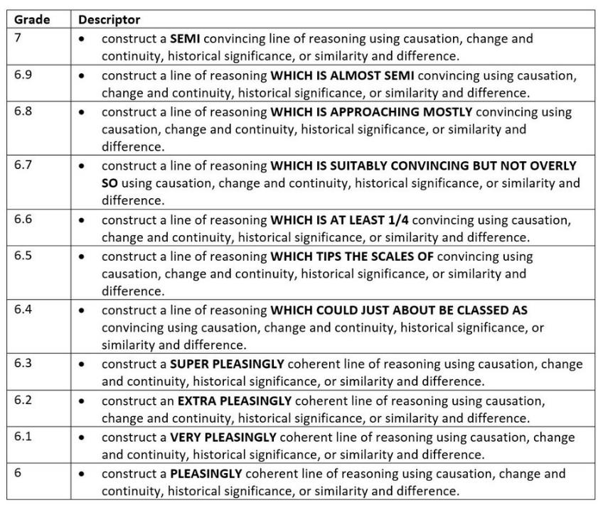
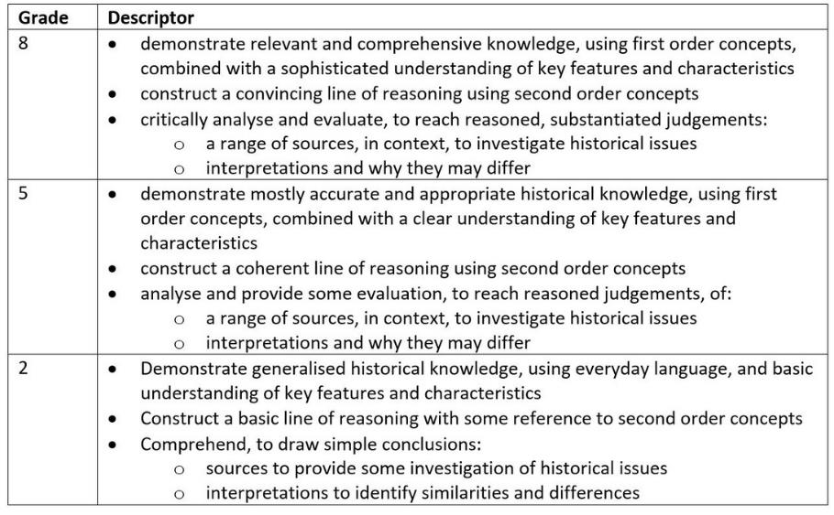
A working solution?

Slide 18
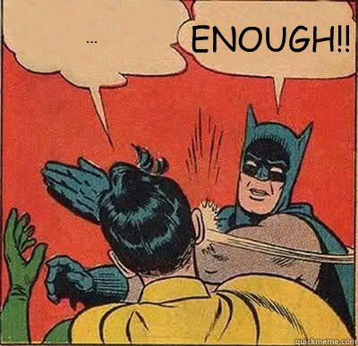

Slide 19
Developing a Progression Model
Focus on mastery and gold standards not ladder creation.
Based on research therefore a genuine progression model for historical thinking.
Avoid linguistic vagueness by focusing on misconceptions.
Allow teachers to plan for progression & give meaningful feedback.

Slide 20
A Guidepost Approach to Causal Thinking
 | Lacking understanding | Powerful understanding
Signpost 1 Causal Webs | Causation is attributed to a single cause, usually ST, or multiple causes are given but not explained. | Multiple short term and long terms causes of events are identified and explained. Relationships between causes are recognized
Signpost 2 Ranking Causes | There is no differentiation between the influence of various causes. | The causes of historical change are analysed and different causes are ranked by their influence
Signpost 3 Underlying Causes | Historical causes are personalized to be the actions of great leaders or are seen as abstractions with human intentions. | Historical change is explained through the interplay of the actions of historical actors and the underlying conditions (SPERM) in which they operated
Signpost 4 Unintended Consequences | Past events are seen as the result of specific plans and actions. | A differentiation is made between the intended and unintended consequences of actions

Slide 21
Visualising students’ thinking

Slide 22
Developing a Progression Model
 | Lacking Understanding | Powerful understanding
Signpost 1 Identifying Change | Seeing the past as homogenous and unchanging. Failing to perceive that changes happen over time. | Understanding that changes can been seen as differences between two periods of time ie. What has changed between two points in history, or conversely, what has stayed the same.
Signpost 2 Interweaving Continuity and Change | Failing to appreciate that continuity and change can happen simultaneously. | Continuity and change are shown to be INTERWOVEN. Some things change whilst others remain stable.
Signpost 3 Process of Change | Seeing all changes as individual events with short term impacts. | Understanding that historical change and can be described as a flow over a longer period of time in terms of pace, extent, trends or specific turning points and that these flows might have greater importance than the changes individually.
Signpost 4 Complexity of Change | Believing that change is a single process which ebbs and flows over time. | Understanding that the past is formed of multiple lines of development and that each has its own flow but that these do not always go in the same direction as the larger river of history.
Causation
Change and Continuity
Historical Evidence
Historical Interpretation
World Views
Communication
What GUIDEPOSTS would indicate a mastery of Change & Continuity?
What misconceptions would need to be overcome?

Slide 23
Get Creative
There are major differences between modern WORLD-VIEWS and those of people in the past, this means their beliefs, values and motivations. We must avoid PRESENTISM.
The perspectives of HISTORICAL ACTORS are best understood by thinking about the CONTEXT in which people lived and the WORLD-VIEWS that influenced them.
Looking at the perspective of an HISTORICAL ACTOR means drawing INFERENCES about how people thought and felt in the past. It does not mean using modern WORLD-VIEWS to imagine the past.
“Any good history begins in strangeness. The past should not be comfortable. The past should not be a familiar echo of the present…The past should be so strange that you wonder how you and the people you know and love could come from such a time…When you have traced this trajectory, you have learnt something.”
(White, 1998, p. 13)

Slide 24
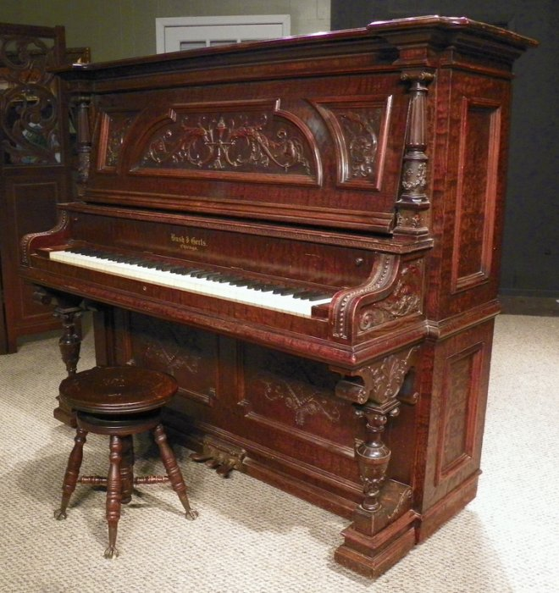
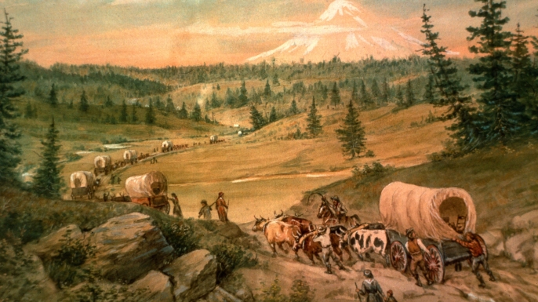
The Rocky Mountains

Slide 25
Realising there is still a mountain to climb!

Slide 26
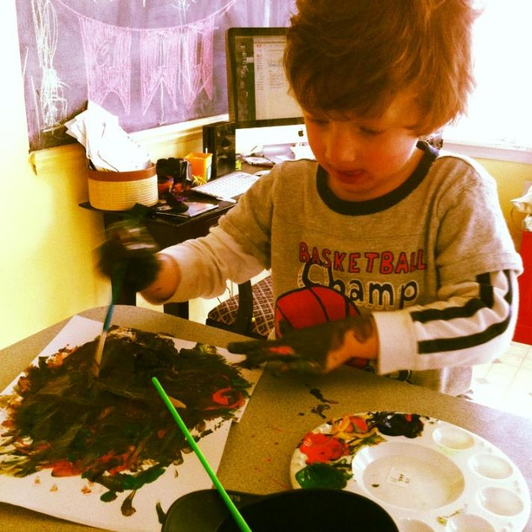
Key distinctions
Making progress in what?....
Substantive knowledge = “stuff” of history
Concepts with historically grounded meanings eg. “king”, “peasant”, “parliament”
Second Order Concepts
Substantive Knowledge & Concepts
Ways of understanding historical content eg. Causation, significance, change & continuity.

Slide 27
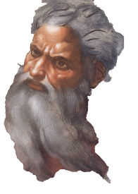
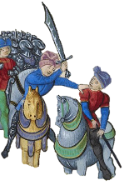
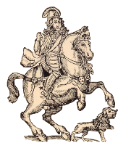
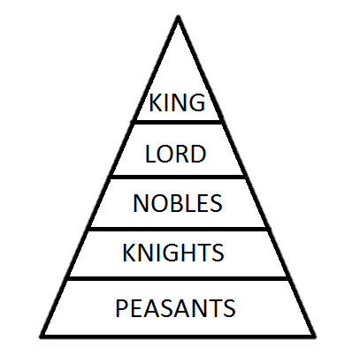
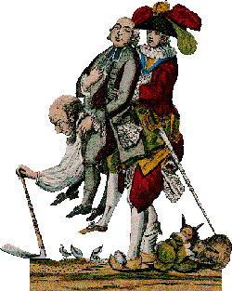
Knowledge and progress – Curriculum Planning
Knowledge is as transferrable and necessary as the conceptual understanding.
Need to consider what “fingertip” knowledge pupils need for a topic, but also what “residual” knowledge topics should leave behind (Counsell)

Slide 28
Ensuring progress in substantive knowledge
Curriculum design
Quizzes
Mind maps
Synoptic essays
Exam questions
Defining concepts
Low-stakes testing
Planning for SK every lesson
Timelines

Slide 29
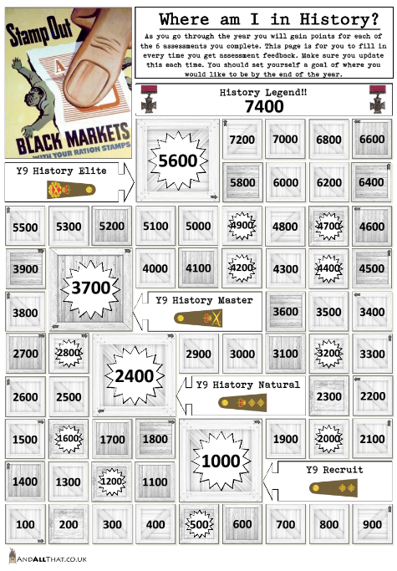
Task-specific assessment
Assessments which unify content and second-order concepts – use of enquiry questions.
Reporting attainment in specific assessments.
Considering progress as accumulation of knowledge AND application of second-order thinking.

Slide 30
How do we assess attainment?
Assessing Attainment
Task/Topic specific
Tasks should get harder over the key stage – demands/content
Assessing knowledge AND conceptual thinking against a defined curriculum
Does not need to fit on a unified, linear scale – more powerful if it does not! MESSY MARKBOOK
Other Aspects
Historical Knowledge
Historical Thinking

Slide 31
Progress is messy!
Pupil A
Pupil B
Progress?
Pupil C
Pupil D
Pupil E
Pupil F
Pupil G
Pupil H
Pupil I

Slide 32
How could we assess progress?
Assessing Progress
A holistic measure over time based on all aspects of student work
Needs to trust teacher judgment
Descriptive of progress over time ie. little, slow, good, rapid
Good | Students are making good progress because they: grasp new ideas and first-order concepts in line with their peers for the most part, although they may not always be fully confident in their understanding. deploy new ideas in their work with limited prompting have an awareness of the links between ideas and concepts previously studied and newer ones being introduced. communicate their ideas effectively most of the time. respond to feedback in the majority of tasks, modifying and refining their ideas and work with reasonable effectiveness. work on overcoming misconceptions meaning that repeated mistakes about ideas or concepts are uncommon. Show sound understanding in assessments, with some variation over time. Are developing their understanding of Second Order concepts and overcoming misconceptions.

Slide 33
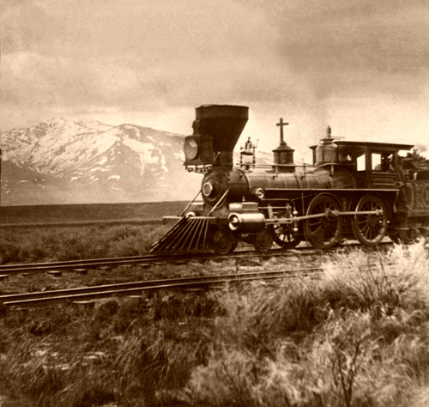
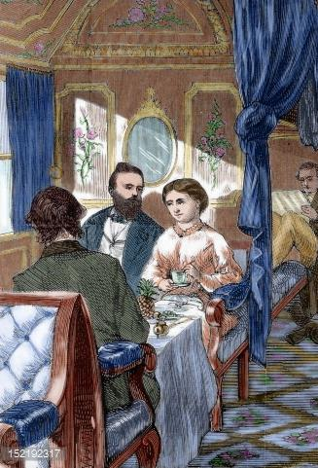
Arrival?

Slide 34
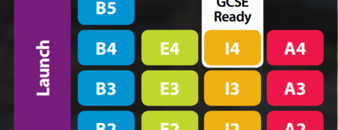
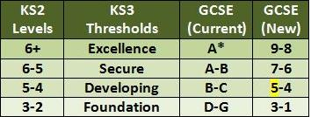
Arrival?

Slide 35
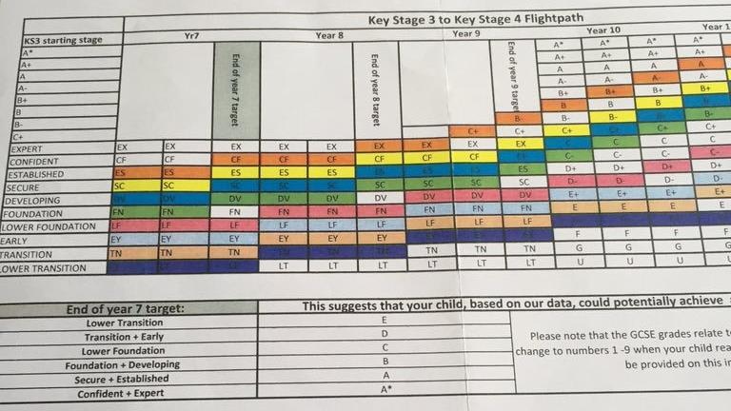

Slide 36
Your journey?
Continue the professional debate and discussion
Look at models which exist
www.andallthat.co.uk
http://clioetcetera.wordpress.com/
Guidance from Commission on Assessment Without Levels
Guidance from ASCL
Key points
Stay focused on the purpose of assessment
Build your progression model carefully – focus on the gold standard and misconceptions not ladders
Avoid taking too much baggage with you
Resist attempts at over-simplification

Slide 37
Further Reading
For a broader discussion of the issues see:
Burnham, S. & Brown, G. (2003) ‘Assessment without level descriptions’ in Teaching History, 113, Creating Progress Edition
Counsell, C. (2004) ‘Editorial’ in Teaching History, 115, Assessment Without Levels? Edition
Fordham, M. (2013) ‘O brave new world, without those levels in't: where now for Key Stage 3 assessment in history?’ in Teaching History, Historical Association Curriculum Supplement, Curriculum Evolution
Lee, P. & Shemilt, D. (2003) ‘A scaffold not a cage: progression and progression models in history’ in Teaching History, 113, Creating Progress Edition
Seixas, P. & Morton, T. (2012) The Big Six Historical Thinking Concepts, Toronto, Nelson Education.
Also recommend reading the whole of Teaching History Issue 157 which has articles on assessment after levels, progression models, knowledge testing, assessing substantive knowledge and using timelines in assessment

