Slide 1
Setting us free? Making Progression & Assessment Meaningful in a Post-Levels World
Alex Ford – Leeds Learning Partnership History Conference, Feb 2014

Slide 2
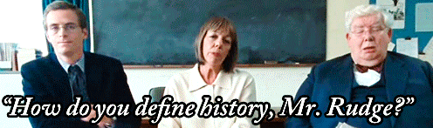
Context
“As part of our reforms to the national curriculum , the current system of ‘levels’ used to report children’s attainment and progress will be removed. It will not be replaced.” (DfE, 2013)
So what next for progress and progression in History?

Slide 3
Key Definitions
Attainment – a measure of understanding at a particular point
Progress – the development of a child’s abilities, knowledge and understanding over time
Progression Model – the system which underpins how students improve their understanding of the subject

Slide 4
Problem with NC Levels: Attainment
 | Interpretations
Level 4 | They identify and describe different ways in which the past has been interpreted
Level 5 | They suggest some reasons for different interpretations of the past
Level 6 | They begin to explain how and why different interpretations of the past have arisen
Level 7 | They explain how and why different interpretations of the past have arisen
Never intended to measure attainment in individual pieces of work
Too broad and lack specific focus
Don’t offer a description of what improvement looks like
Even at end of Key Stage – a best-fit doesn’t always work

Slide 5
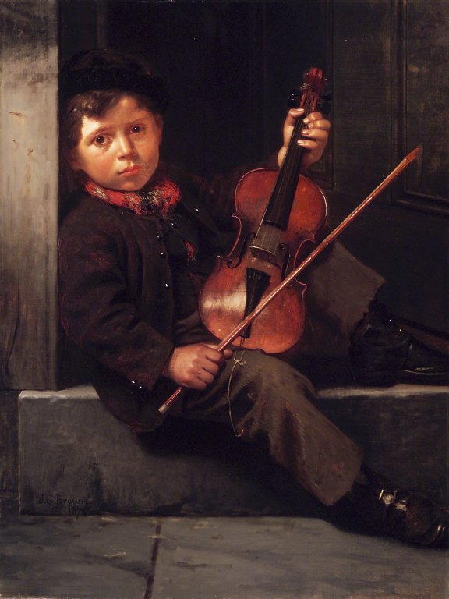
Problem with NC Levels: Progress
Never intended to be used to measure progress AT ALL!!
Do not describe change over time
Using numerical system suggests linear progress should be made
Progress does not tie into assessments – no parity
Confuses students and parents (as Gove pointed out)
Made worse by Ofsted demands for progress

Slide 6
Problem with NC Levels: Progression
Demonstrate a clear understanding of the complexities of the relationship between cause, consequence and change
Demonstrate an awareness of human motivation illustrated by reference to events of the past
Demonstrate an awareness of the problems inherent in the idea of causation
Demonstrate, by reference to stories of the past, an awareness that actions have consequences
Produce a well-argued hierarchy of causes for complex historical issues
Recognise everyday time conventions
Understand that historical events have different types of causes and consequences
Understand that historical events usually have more than one cause and consequence
When examining historical issues, can draw the distinction between causes, motives and reasons
When explaining historical issues, place some causes and consequences in a sensible order of importance
They do not and cannot fully underpin an historical education
Fail to describe what progression in historical understanding looks like:
Level 4 “Describe”
Level 5 “Explain”
Level 6 “Analyse”
Level 7 “Evaluate”
‘…moving from National Curriculum Level 4 to Level 5 (or whatever) is not an adequate description of progress let alone a prescription for progress.’ (Counsell, 2000, p. 41)

Slide 7
Where NEXT?
1) Develop a common understanding of good history – a gold standard
2) Establish what it means to get better at history
3) Plan for how these features will be delivered and assessed meaningfully
4) Get your SMT onside

Slide 8
Establishing a Gold Standard
1) Develop a common understanding of good history – a gold standard
2) Establish what it means to get better at history
3) Plan for how these features will be delivered and assessed meaningfully
4) Get your SMT onside

Slide 9
Establish a Gold Standard
Purpose?
Bloch: History as a Craft to be mastered
Dispositions of thinking: enquiry for example
Conceptual understanding
Substantive knowledge
A key debate to be had – need to bring in a broad range of resources

Slide 10
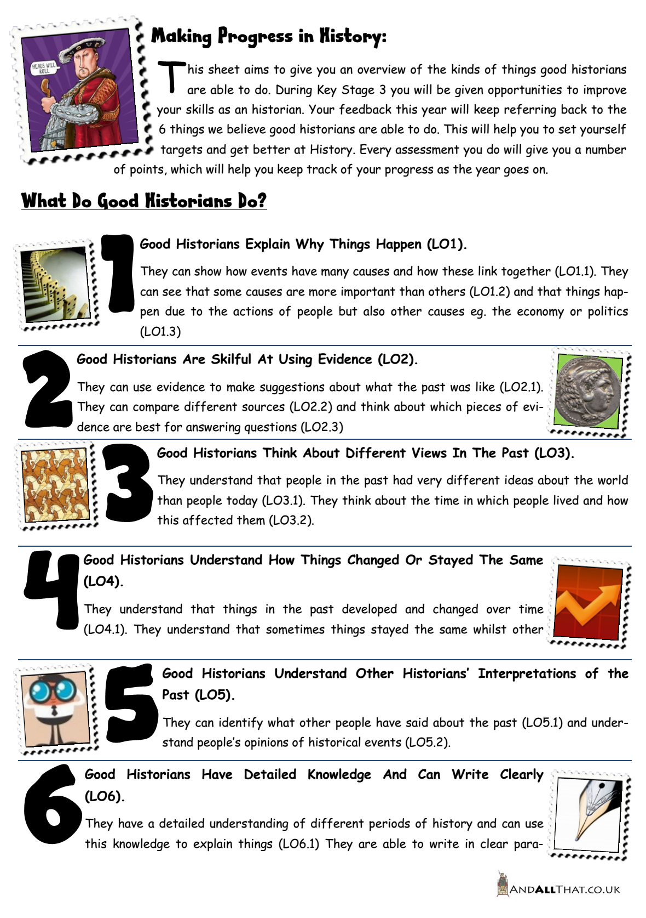
Establish a Gold Standard
“Competent historical thinkers understand both the vast differences that separate us from our ancestors and the ties that bind us to them; they can analyse historical artefacts and documents, which can give them some of the best understandings of times gone by; they can assess the validity and relevance of historical accounts, when they are used to support entry into a war, voting for a candidate, or any of the myriad decisions knowledgeable citizens in a democracy must make. All this requires “knowing the facts,” but “knowing the facts” is not enough. Historical thinking does not replace historical knowledge: the two are related and interdependent.” (Seixas, 2008, p. 6)

Slide 11
Developing a Progression Model
1) Develop a common understanding of good history – a gold standard
2) Establish what it means to get better at history
3) Plan for how these features will be delivered and assessed meaningfully
4) Get your SMT onside

Slide 12
Developing a Progression Model
What will it look like for students to move towards the gold standard
Seeing the subject as a craft to be mastered helps

Slide 13
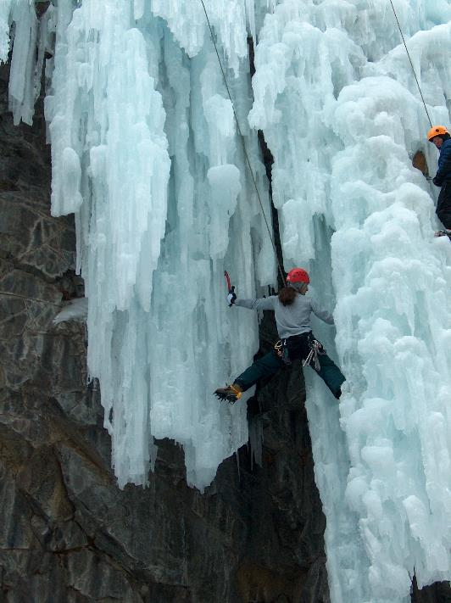
Developing a Progression Model

Slide 14
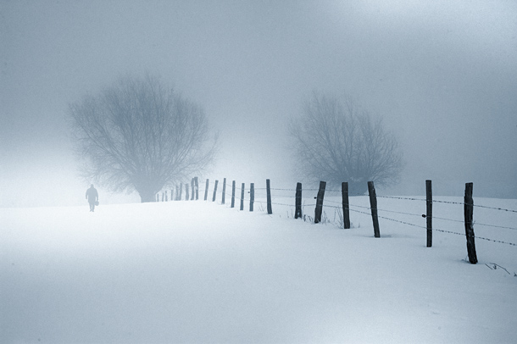
Developing a Progression Model

Slide 15
Developing a Progression Model

Slide 16
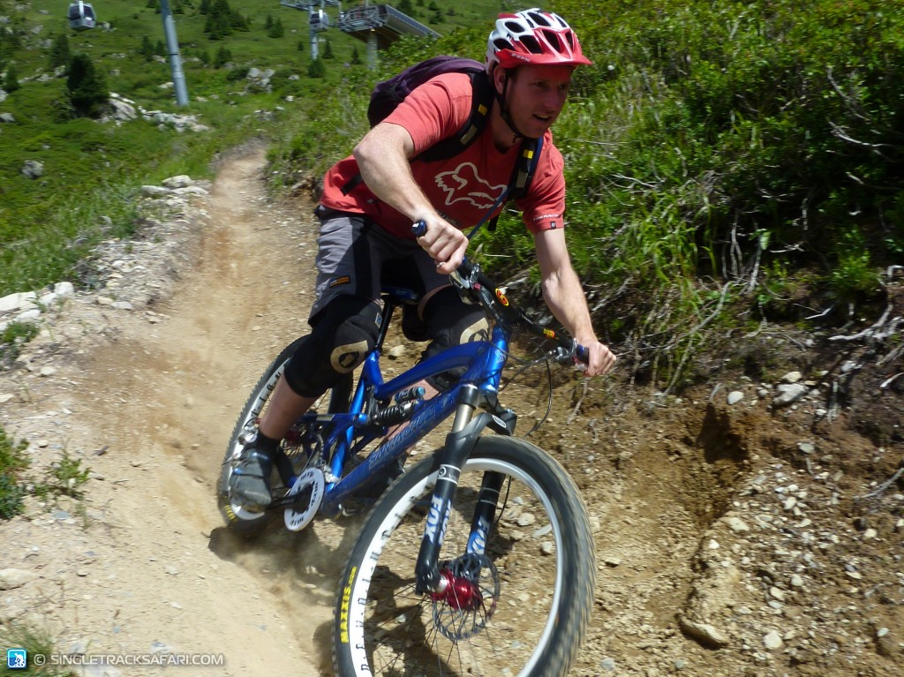
Developing a Progression Model

Slide 17
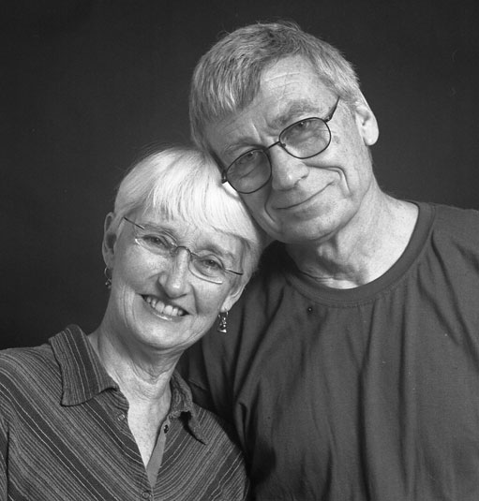
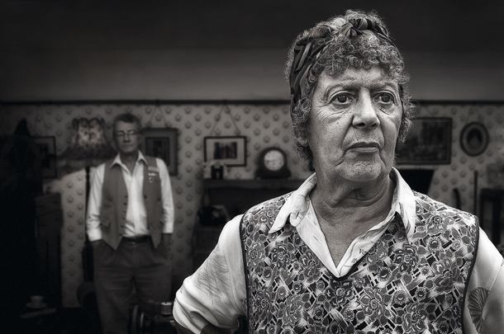
Developing a Progression Model

Slide 18
Developing a Progression Model
Seixas and Morton Historical Thinking Project
Guideposts of concepts for students to master
Misconceptions they need to overcome
Based on research and experience
Not creating ladders - can be tackled at different rates and in different orders

Slide 19
Causation: Mastery Model (Scott, 1990; Morton & Seixas, 2012)
Signpost 1 Causal Webs | Causation is attributed to a single cause, usually ST, or multiple causes are given but not explained. | Multiple short term and long terms causes of events are identified and explained. Relationships between causes are recognized
Signpost 2 Ranking Causes | There is no differentiation between the influence of various causes. | The causes of historical change are analysed and different causes are ranked by their influence
Signpost 3 Underlying Causes | Historical causes are personalized to be the actions of great leaders or are seen as abstractions with human intentions. | Historical change is explained through the interplay of the actions of historical actors and the underlying conditions (SPERM) in which they operated
Signpost 4 Unintended Consequences | Past events are seen as the result of specific plans and actions. | A differentiation is made between the intended and unintended consequences of actions

Slide 20
Developing a Progression Model
What GUIDEPOSTS would indicate a mastery of Change & Continuity?
What misconceptions would need to be overcome?
Causation
Change and Continuity
Historical Evidence
Historical Interpretation
World Views
Communication

Slide 21
Implementing the Model – Planning and Assessment
1) Develop a common understanding of good history – a gold standard
2) Establish what it means to get better at history
3) Plan for how these features will be delivered and assessed meaningfully
4) Get your SMT onside

Slide 22
Curriculum Planning

Slide 23
Assessment
Must not conflate attainment and progress – separate measures
Mixed Models of Assessment
Formative feedback (progress)
Knowledge Checks
Formal assessment (attainment)

Slide 24
Whole School Issues
Need to push for a model of whole school reporting which does not conflate attainment and progression
Need to accept that progress is not a linear value
Report result of last assessment:
Pass/Merit/Distinction etc.
Report a description of progress based on conceptual understanding AND substantive knowledge:
None, Slow, Good, Rapid etc.

Slide 25
PROGRESS DESCRIPTOR | INDICITIVE EVIDENCE
None | Students are a cause for concern because they: fail to grasp new ideas and concepts introduced in lessons do not deploy new ideas or concepts in their written, or other work fail to communicate their ideas effectively do not respond to feedback in a meaningful way, or ignore feedback altogether. repeatedly make the same mistakes and do not move beyond misconceptions they have developed about the subject despite being given feedback and assistance. Show little or no understanding in assessments.
Slow | Students need further support because they: grasp new ideas and concepts more slowly than their peers, and seem less confident in their understanding. struggle to deploy new ideas and concepts in their work, or may need prompting in order to do so effectively struggle with some aspects of communicating their ideas effectively respond to feedback to some extent, but do not always address the issues being identified. overcome some of their misconceptions about the subject but continue to make similar mistakes. This improves with support. Show some understanding in assessments, although this may vary over time.

Slide 26
PROGRESS DESCRIPTOR | INDICITIVE EVIDENCE
Good | Students are making good progress because they: grasp new ideas and concepts in line with their peers for the most part, although they may not always be fully confident in their understanding. deploy new ideas and concepts in their work with limited prompting have an awareness of the links between ideas and concepts previously studied and newer ones being introduced. communicate their ideas effectively most of the time. respond to feedback in the majority of tasks, modifying and refining their ideas and work with reasonable effectiveness. work on overcoming misconceptions about the subject meaning that repeated mistakes about ideas or concepts are uncommon. Show sound understanding in assessments, with some variation over time.
Rapid | Students are making rapid progress because they: grasp the vast majority of new ideas and concepts quickly and confidently. show good awareness of the links between ideas and concepts previously studied and newer ones being introduced. Communicate their ideas effectively for the vast majority of the time. respond well to feedback and refine ideas and work effectively. work to overcome misconceptions about the subject seldom continuing to make the same mistakes in work Show good understanding in assessments with little variation over time.

Slide 27
Getting SMT Onside
1) Develop a common understanding of good history – a gold standard
2) Establish what it means to get better at history
3) Plan for how these features will be delivered and assessed meaningfully
4) Get your SMT onside

Slide 28
Next Steps
TALK TO YOUR SMT!!
Open up debate and discussion as a profession. Share models, assessments, student progression models and ideas
History Teachers Discussion Forum
www.andallthat.co.uk/blog
http://clioetcetera.wordpress.com/
Range of other concepts, examples and ideas online
Opportunity to lead other subjects and whole school practice – get the assessment that we want. FIGHT FOR IT!

Slide 29
History is not a means to an ends, it is both the means and the ends. It is a complex process of developing a substantive knowledge of the past, whilst also building a conceptual framework for understanding what we find there. It is both a mental disposition, and a visceral connection with our own history and identity…

