Slide 1
Seeing the wood AND the trees: What does making progress actually look like in history?
Alex Ford

Slide 2
Alex Ford &
Becky Goult
Lead Tutor for PGCE History, LTU
Subject Lead & Head of Year 7, Mossbourne Academy
SHP Regional Advisor
@apf102; @andallthatweb
Teach First Associate Tutor

Slide 3
So what do we mean when we say pupils have “made progress” in history?
They have gained new knowledge and connected this to existing knowledge.
They have developed transferrable critical thinking skills.
They can apply knowledge and understanding in disciplinary appropriate ways eg. judging significance.
They demonstrate 21st century skills.
They have moved from one stage of a curriculum ladder to another eg. from a Level 3b to 3a.
They have made more than 3 levels of progress between Key Stage 2 and Key Stage 4
Which of these offers the BEST definition of progression IN HISTORY?
Which offers the worst?

Slide 4
Teacher Standards & Progress
But what does progress LOOK LIKE?
TS2: Promote good progress and outcomes by pupils
Be accountable for pupils’ attainment, progress and outcomes
Be aware of pupils’ capabilities and their prior knowledge, and plan teaching to build on these
Guide pupils to reflect on the progress they have made and their emerging needs
TS6: Make accurate and productive use of assessment
Make use of formative and summative assessment to secure pupils’ progress.

Slide 5
Two major ways to consider progression
Substantive Knowledge & Concepts
Substantive knowledge = “stuff” of history
Concepts with historically grounded meanings eg. “king”, “peasant”, “parliament”
Second Order Concepts
Ways of understanding historical content eg. Cause & consequence, historical significance, change & continuity, similarity & difference etc.
Could also consider key processes eg. Enquiry

Slide 6
Progression in Second Order concepts
Dominant means of assessment in Key Stage 3.
Students asked to improve their disciplinary thinking by moving up through ladder like stages.
Usually split into the main second-order concepts (4-7 depending on who you ask)
Still the most common means of assessing progress even after the removal of NC Levels.

Slide 8
Problems with thinking of progression as linear
Demonstrate a clear understanding of the complexities of the relationship between cause, consequence and change
Demonstrate an awareness of human motivation illustrated by reference to events of the past
Demonstrate an awareness of the problems inherent in the idea of causation
Demonstrate, by reference to stories of the past, an awareness that actions have consequences
Produce a well-argued hierarchy of causes for complex historical issues
Recognise everyday time conventions
Understand that historical events have different types of causes and consequences
Understand that historical events usually have more than one cause and consequence
When examining historical issues, can draw the distinction between causes, motives and reasons
When explaining historical issues, place some causes and consequences in a sensible order of importance
Challenge 1
Take the 10 “level descriptors” for causal reasoning and put them in a sensible order to show progression.

Slide 9
Level 1 – Recognise everyday time conventions
Level 2 – Demonstrate, by reference to stories of the past, an awareness that actions have consequences
Level 3 – Demonstrate an awareness of human motivation illustrated by reference to events of the past
Level 4 – Understand that historical events usually have more than one cause and consequence
Level 5 – Understand that historical events have different types of causes and consequences
Level 6 – When explaining historical issues, place some causes and consequences in a sensible order of importance
Level 7 – When examining historical issues, can draw the distinction between causes, motives and reasons
Level 8 – Produce a well-argued hierarchy of causes for complex historical issues
Level 9 – Demonstrate an awareness of the problems inherent in the idea of causation
Level 10 – Demonstrate a clear understanding of the complexities of the relationship between cause, consequence and change
Challenge 2: Which level do the pieces of work fit in?
Challenge 3: What advice would you give to each student?

Slide 10
Re-thinking linear progression models
Start with a gold standard for historical thinking and DON’T try to subdivide it!
Consider what competent thinking looks like AND the misconceptions which might get in the way.
Identify and tackle the misconceptions to help pupils move on in their disciplinary thinking.

Slide 11
Guidepost model of causation
Signpost 1 Causal Webs | Causation is attributed to a single cause, usually ST, or multiple causes are given but not explained. | Multiple short term and long terms causes of events are identified and explained. Relationships between causes are recognized
Signpost 2 Ranking Causes | There is no differentiation between the influence of various causes. | The causes of historical change are analysed and different causes are ranked by their influence
Signpost 3 Underlying Causes | Historical causes are personalized to be the actions of great leaders or are seen as abstractions with human intentions. | Historical change is explained through the interplay of the actions of historical actors and the underlying conditions (SPERM) in which they operated
Signpost 4 Unintended Consequences | Past events are seen as the result of specific plans and actions. | A differentiation is made between the intended and unintended consequences of actions
Challenge 4:
Re-assess the work. What does each person need to work on? What advice would you give them?
MORE EXAMPLES HERE: http://www.andallthat.co.uk/blog/progression-in-historical-thinking-updated

Slide 12
What happened to substantive knowledge?
Only assessing historical thinking is problematic!
Fails to acknowledge that Second Order concepts are only useful in making sense of historical knowledge.
Concepts are rooted ie. A causal explanation of William’s victory at Hastings might be quite different from an explanation of the failure of the Peasants’ Revolt
So how do we assess BOTH?

Slide 13
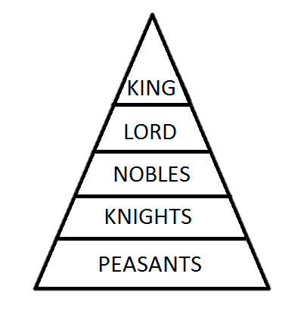
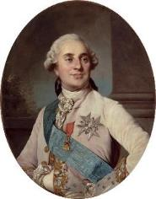
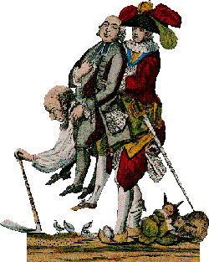
Knowledge and Progress
How do we plan to develop:
Knowledge of context
Knowledge of key people and events
Knowledge of substantive concepts eg. “peasant”, “aristocrat”, “friar”, “president”, “slave” and how these change.
Need to consider what “fingertip” knowledge pupils need for a topic, but also what “residual” knowledge topics should leave behind (Counsell)
How do we assess these?

Slide 14
Looking for substantive sophistication
How do we spot substantive sophistication?
Look at the two examples. Both are “A” grades, but which is better?
Wider historical knowledge
Period Knowledge
Topic knowledge
See Hammond (2014) “The Knowledge that Flavours a Claim” TH 157

Slide 16
Ensuring progress in substantive knowledge
How could we make sure that pupils make progress in their substantive knowledge?
Curriculum design
Quizzes
Mind maps
Synoptic essays
Exam questions
Defining concepts
Processing information
Planning for SK every lesson
Timelines

Slide 17
How learning works
Encoding – sensory data turned into sketchy memories like brief notes – quickly forgotten. If you are not focussed this can’t happen.
Consolidation – memory traces are processed and made stable – needs brain action
Memory becomes stronger the more it is retrieved from LT memory, re-processed and re-written.
Testing is a great way to achieve this
Sensory Memory
Forgetting
Encoding
Short Term Memory
Forgetting
Retrieval
Consolidation
Long Term Memory
Forgetting
Notes:
Three processes explain how the brain learns – can optimise our teaching to encourage the brain to learn and grow.
Sensory memory – takes information from the senses. These are forgotten unless processed. Many people fall down here because they simply don’t pay attention??? If you are not taking the information in, it cannot be used!
Encoding – the process of moving sensory data to ST memory for immediate processing. Much forgotten here without consolidation.
Consolidation – memory traces are made stable in LT memory. This happens through processing information. ie. through retrieval, modification, elaboration etc etc.
Once in LT memory – information is strengthened by retrieval. The more you think back to things and work done, the more the memories are strengthened and the more durable they become. Testing is therefore a way to help your brain make connections and learn.

Slide 18
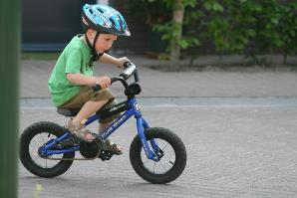
Tip 5: Setting memory cues
Getting CUES sorted is key
Most of our LT memory is only accessible through cues
When riding a bike you learn the cues that you are falling left or right and what to do
You also learn cues for stopping (an approaching crowd) and react
1933?
1953?
1929?
1939?
Things go wrong if the cues get the wrong information. Eg. If your bike had a pedal brake not a hand brake
Notes:
One of the best ways for our brain to develop its retrieval potential is by setting up memory cues. These could be basic associations or more complex
Ideally we need to be in a position where cues spark memories in an almost subconscious way. When riding a bike – a sense of falling left or right encourages us to correct things – seeing an obstacle makes us brake. Things go wrong if the cues change.
We need to create cues for our own learning so that we retrieve the right information.

Slide 19
Point out patterns!
Now write the number
96557317
=1
=5
=2
=6
=3
=7
=8
=4
=9

Slide 20
Look for patterns
1 | 2 | 3
4 | 5 | 6
7 | 8 | 9
Once you find a pattern remembering things becomes easier
1 | 2 | 3
4 | 5 | 6
7 | 8 | 9

Slide 21
4 key events in German history
1923:
Hyperinflation
1929:
Wall St Crash
1923:
Munich Putsch
1933:
Hitler becomes Chancellor

Slide 22
Four Steps to Hyperinflation
Stop paying
reparations
Stop production
Print more money
French invade

Slide 23
Some more suggestions on developing substantive knowledge…

Slide 24
Bringing it all together: KNOWLEDGE & SECOND ORDER CONCEPTS

Slide 25
How can we develop BOTH knowledge and conceptual understanding?
Through ENQUIRY

Slide 26
Enquiry Questions
Build around a key enquiry (Riley, 2000):
Unifies SO Concept & Substantive Knowledge
Captures interest
Provides a genuine and substantial outcome
Chapman:
An enquiry question poses a discrete problem that to solve.
An enquiry question should aim to motivate pupils (with the desire to solve it).
An enquiry question should be historically rigorous (i.e. encourage historical thinking).
A good enquiry question should be ‘open’ (capable of being answered in a range of ways)

Slide 27
Good Idea? Bad Idea?
What did the Nazis do in Germany?
Why didn’t medicine improve much during the Middle Ages?
Was Louis XVI responsible for his own downfall?
Why was there a revolution in France in 1789?
When did the First World War become inevitable?
Why did the slave trade end?
Is Clarkson the forgotten hero of abolition?
Why do historians disagree about the abolition of the slave trade?
Why has life expectancy increased so much in the twentieth century?
Was there a common experience of the Industrial Revolution?
Who shot JFK?
Why did women get the vote in 1928 and not before?
What was life in the trenches like?

Slide 28
TASK SPECIFIC mark schemes
Go through the mark scheme and highlight:
Where SECOND ORDER THINKING is mentioned
Where SUBSTANTIVE KNOWLEDGE is mentioned
Other aspects which are being assessed

Slide 29
Messiness & Meaning
What could we learn from this mark book?

Slide 30
Measuring Progress on the Ground – Notes from the Field

